Slide 1

Organizational Behavior
(MGT-502)
Lecture-8

Slide 2
Summary of
Lecture-7

Slide 3
Attitudes
Values

Slide 4
Components of Attitudes
Cognitive -- thinking
Affective -- feeling
Behavioral -- doing

Slide 5
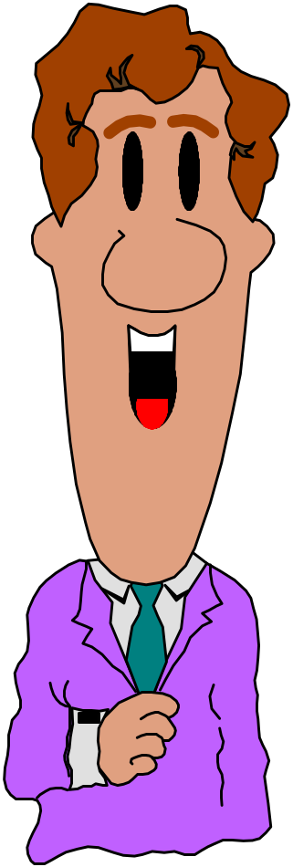
Types of Attitudes
Job satisfaction
Job involvement
Organizational commitment

Slide 6
Outcomes of Job Satisfaction
Satisfaction and Productivity
Satisfaction and Turnover
Satisfaction and Absenteeism
Satisfaction and Citizenship Behavior

Slide 7
Barriers to Change Attitudes
Prior Commitments
Insufficient Information

Slide 8
Today’s Topics

Slide 9
Personality defined
Relatively stable pattern of behaviours and consistent internal states that explain a person's behavioural tendencies.

Slide 10
Personality
The sum total of ways in which an individual reacts and interacts with others.

Slide 11
Personality
Mean how people affect others and how they understand and view themselves, as well as their pattern of inner and outer measurable traits and
Person-situation interaction

Slide 12
Personality
Personality refers to a relatively stable set of feelings and behaviors that have been significantly formed by genetic and environmental factors.
Personality is a product of Nature and Nurture
Nurture
Pattern of life experiences
Nature
Hereditary
forces

Slide 13
What Is Personality?
Heredity
Environment
Situation

Slide 14
Some Major Forces Influencing Personality
Cultural forces
Individual
Personality
Social class and other group membership forces
Hereditary forces
Family relationship forces

Slide 15
Personality
Personality
  The relatively stable set of psychological attributes that distinguish one person from another.
The “Big Five” Personality Traits
  A set of fundamental traits that are especially relevant to organizations.
  The traits include agreeableness, conscientiousness, negative emotionality, extraversion, and openness.

Slide 16
The Big Five Personality Model
Extroversion
  Refers to the tendency to be sociable, friendly, and expressive.
Emotional Stability
  Refers to the tendency to experience positive emotional states.
Agreeableness
  Being courteous, forgiving, tolerant, trusting, and self-hearted.

Slide 17
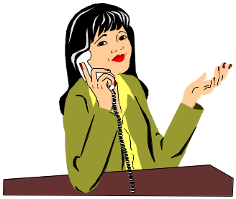
Conscientiousness
  Is exhibited by those who are described as dependable, organized, and responsible.
Openness to Experience
  Reflects the extent to which an individual has broad interests and is willing to be a risk-taker.

Slide 18
Relationship Between The “Big Five” Personality Dimensions And Career
The “Big Five” traits are significantly related to both intrinsic (job satisfaction) and extrinsic (income and occupational status) career success.

Slide 19
Big five personality dimensions
Conscientiousness
Caring, dependable
Emotional stability
Poised, secure
Openness to experience
Sensitive, flexible
Agreeableness
Courteous, empathic
Extroversion
Outgoing, talkative

Slide 20
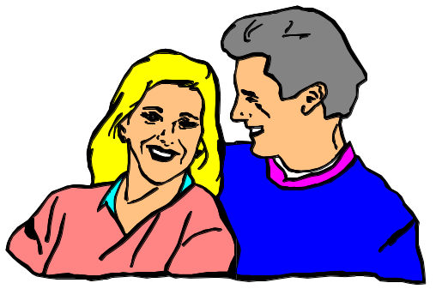
The Myers-Briggs Framework
This framework differentiates people in terms of four general dimensions: sensing, intuiting, judging, and perceiving. Higher and lower positions in each of the dimensions are used to classify people into one of sixteen different personality categories.

Slide 21
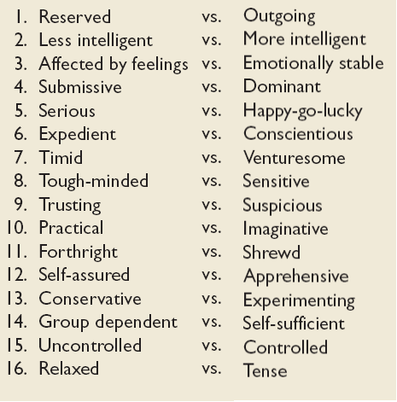
Sixteen Primary Traits

Slide 22
Personality Traits
Trusting
Practical
Forthright
Self-Assured
Conservative
Group-Dependent
Uncontrolled
Relaxed
Suspicious
Imaginative
Shrewd
Apprehensive
Experimenting
Self-Sufficient
Controlled
Tense

Slide 23
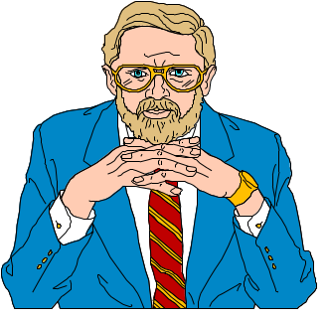
Other Personality Traits at Work
Self-Efficacy
  A person’s beliefs about his or her capabilities to perform a task.
Authoritarianism
  The extent to which a person believes that power and status differences are appropriate within hierarchical social systems such as organizations.

Slide 24
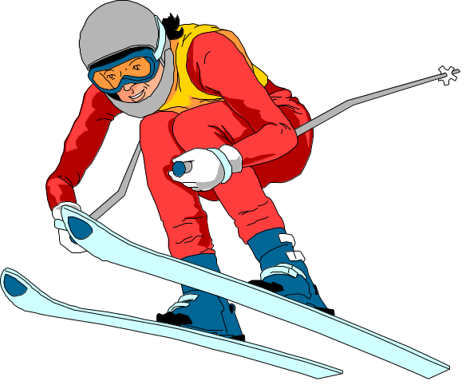
Risk Propensity
  The degree to which a person is willing to take chances and make risky decisions.

Slide 25
Because personality characteristics create the parameters for people’s behavior, they give us a frame work for predicting behavior.

Slide 26

Major Personality Attributes Influencing OB
Locus of control
Self-esteem
Self-monitoring
Propensity for risk taking
Type A personality

Slide 27
Personality Characteristics in Organizations
Locus of Control
Internal
External
I control what
happens to me!
People and circumstances control my fate!
Notes:
9
9
9
8

Slide 28
Personality Characteristics in Organizations
Self-Efficacy - beliefs and expectations about one’s ability to accomplish a specific task effectively
Sources of self-efficacy
  Prior experiences and prior success
  Behavior models (observing success)
  Persuasion
  Assessment of current physical & emotional capabilities
Notes:
10
10
10
9

Slide 29
Personality Characteristics in Organizations
Self-Esteem
Feelings of Self Worth
Success tends
to increase
self-esteem
Failure tends
to decrease
self-esteem
Notes:
11
11
11
10

Slide 30
Personality Characteristics in Organizations
Self-Monitoring
Behavior based on cues from people & situations
High self monitors
  flexible: adjust behavior according to the situation and the behavior of others
  can appear unpredictable & inconsistent
Low self monitors
  act from internal states rather than from situational cues
  show consistency
  less likely to respond to work group norms or supervisory feedback
Notes:
12
12
12
11

Slide 31
Who Is Most Likely to . . .
Low-self monitors
High-self monitors
Get promoted
Accomplish tasks, meet other’s expectations, seek out central positions in social networks
✓
Change employers
✓
Self-promote
Make a job-related geographic move
✓
Demonstrate higher levels of managerial self-awareness; base behavior on other’s cues and the situation

Slide 32
Personality Characteristics in Organizations
A strong
situation can
overwhelm the effects
of individual personalities
by providing strong cues
for appropriate
behavior
Notes:
14
14
14
13

Slide 33
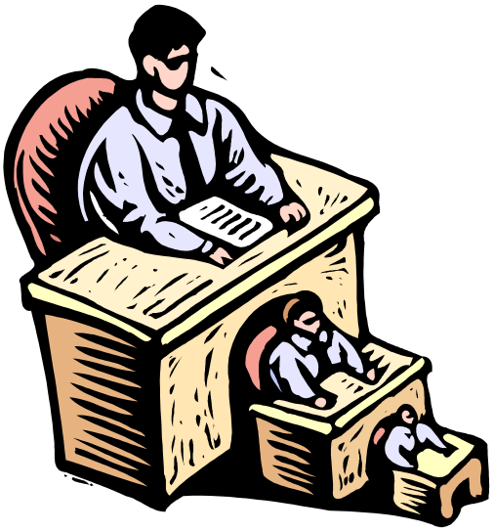
Personality Characteristics in Organizations
Strong
personalities
will dominate
in a weak
situation
Notes:
15
15
15
14

Slide 34
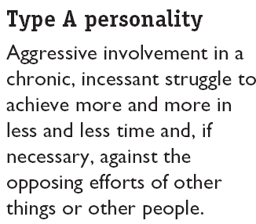
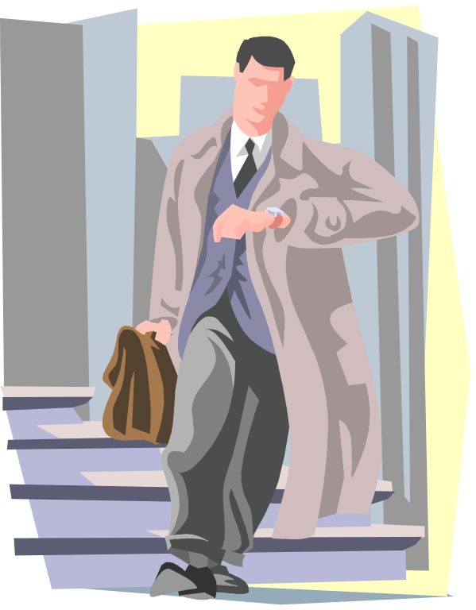
Personality Types

Slide 35
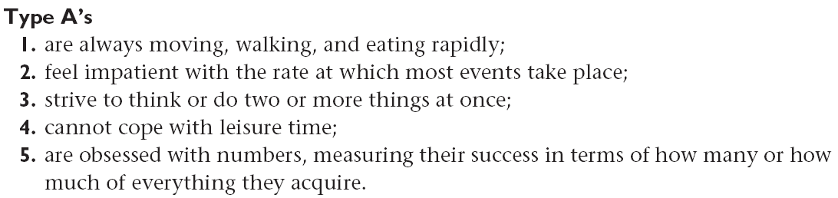
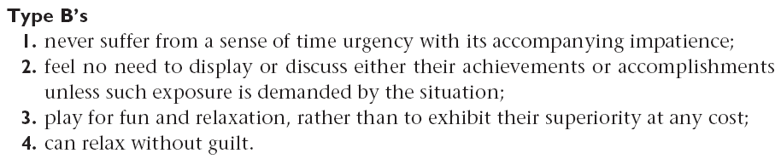
Personality Types

Slide 36
Occupational Personality Types
Realistic
R
Investigative
I
Conventional
C
A
Artistic
E
S
Enterprising
Social

Slide 37
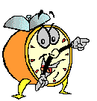
Let’s stop it here

Slide 38
Summary

Slide 39
Personality
Mean how people affect others and how they understand and view themselves, as well as their pattern of inner and outer measurable traits and
Person-situation interaction

Slide 40
Some Major Forces Influencing Personality
Cultural forces
Individual
Personality
Social class and other group membership forces
Hereditary forces
Family relationship forces

Slide 41
Big five personality dimensions
Conscientiousness
Caring, dependable
Emotional stability
Poised, secure
Openness to experience
Sensitive, flexible
Agreeableness
Courteous, empathic
Extroversion
Outgoing, talkative

Slide 42
The Myers-Briggs Framework
This framework differentiates people in terms of four general dimensions: sensing, intuiting, judging, and perceiving. Higher and lower positions in each of the dimensions are used to classify people into one of sixteen different personality categories.

Slide 43
Occupational Personality Types
Realistic
R
Investigative
I
Conventional
C
A
Artistic
E
S
Enterprising
Social

Slide 44
Next….

Slide 45
Emotions and Mood

Slide 46
Organizational Behavior
(MGT-502)
Lecture-8

